Slide 1
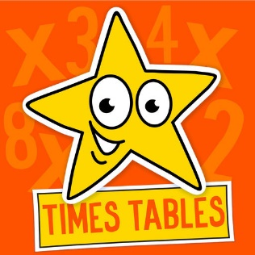
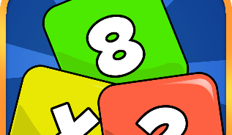
Multiplication Tables Check
Parent / Carer Information
Friday 2nd May 2025

Slide 2


Content
Curriculum expectations
The Multiplication Table Check
Ways you can support at home

Slide 3
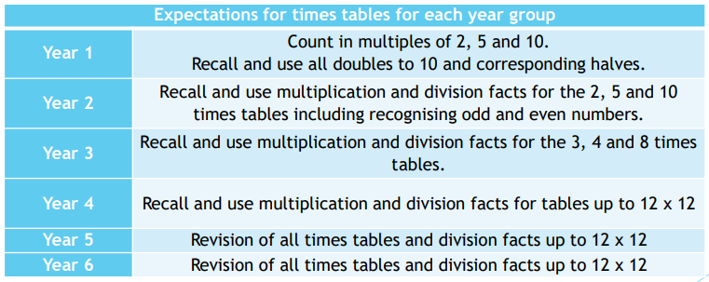
Curriculum Expectations
Primary-school children are expected to know all their times tables up to 12x12 by the end of Year 4.

Slide 4
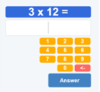
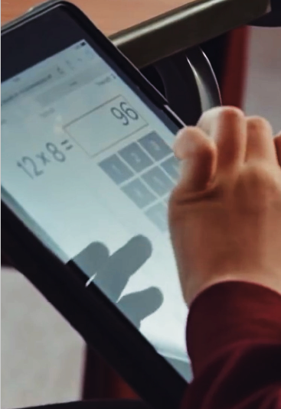
What is the Multiplication Tables Check (MTC)?
Online test:
  3 practice questions
  25 official times table questions
6 seconds to answer each question

Slide 5
What is the purpose of the Multiplication Tables Check?
Helps to see which pupils can recall their times tables fluently
Times tables are crucial for future success in mathematics.
Additional support can be put in for pupils who haven’t mastered their times tables.

Slide 6

When will the children be assessed?
During a 3-week window from the start of June.
Be mindful of holidays during this time.

Slide 7


Slide 8
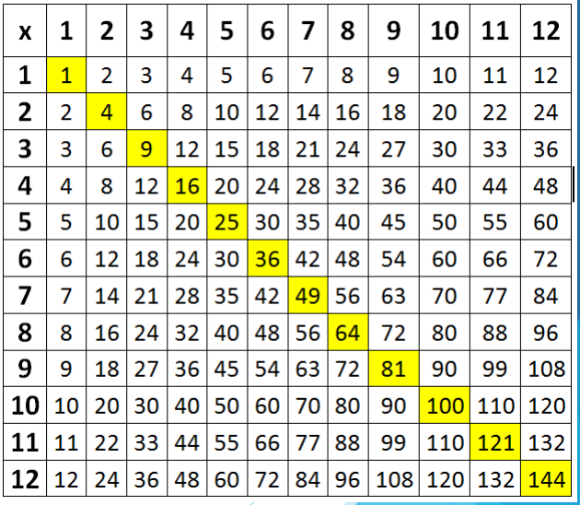

Learning Times Tables
This diagram shows the 144 times tables multiplication facts that every child needs to know.
Sometimes, children can get anxious or worried about learning all these facts.
Children need to be able to recall any times tables answer within two or three seconds.
Counting
Memorise

Slide 9

The order we learn timetables at SRPS
Year 2 – 2x, 10x, 5x,
Year 3 – 3x, 4x, 8x,
Year 4 – 11x, 6x, 7x, 9x, 12x

Slide 10
Tips
Stick to one table at a time to minimise confusion.
Start with chanting and writing them out slowly in order.
Then move on to completing the answers quickly in order – on paper or verbally with your child.
Finally, move on to completing the answers in any order.
Keep reminding your child that 3 x 4 is the same as 4 x 3.
Each table has a square number 3 x 3, 7 x 7 etc. These are special numbers that can act as a memory hook – emphasise them!
Talk about the numbers as you reach them “ 5 x 7 = 35 that’s our house number” – this makes more memory hooks.

Slide 11

Language
3 x 8 =
Three times eight is…
Three multiplied by eight…
Three eights are…
Three lots of eight…
Three groups of eight…

Slide 12

What language do we use?

Slide 13
How to support your child…
Stanley Road Primary School Website – Curriculum – Mathematics
https://www.stanleyroad.worcs.sch.uk/mathematics/
Virtual calculation policy – Multiplication
https://www.stanleyroad.worcs.sch.uk/wp-content/uploads/2022/02/SR-Virtual-Calculation-Policy-September-2021.pdf

Slide 14
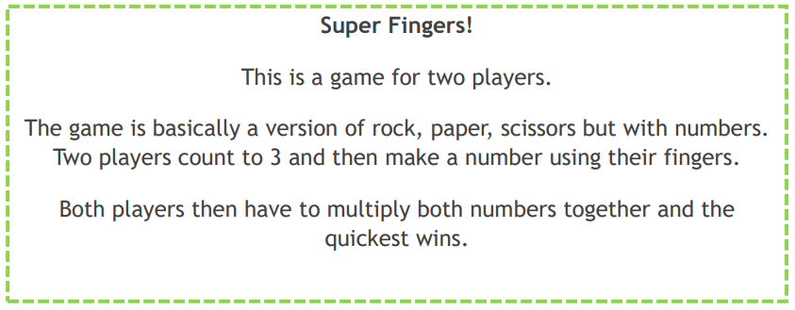
Games to play at home

Slide 15
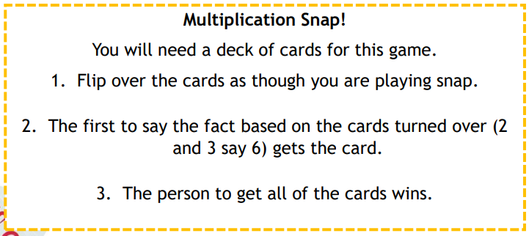
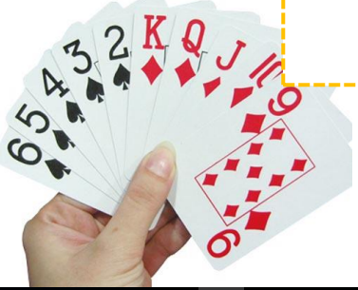
Games to play at home

Slide 16

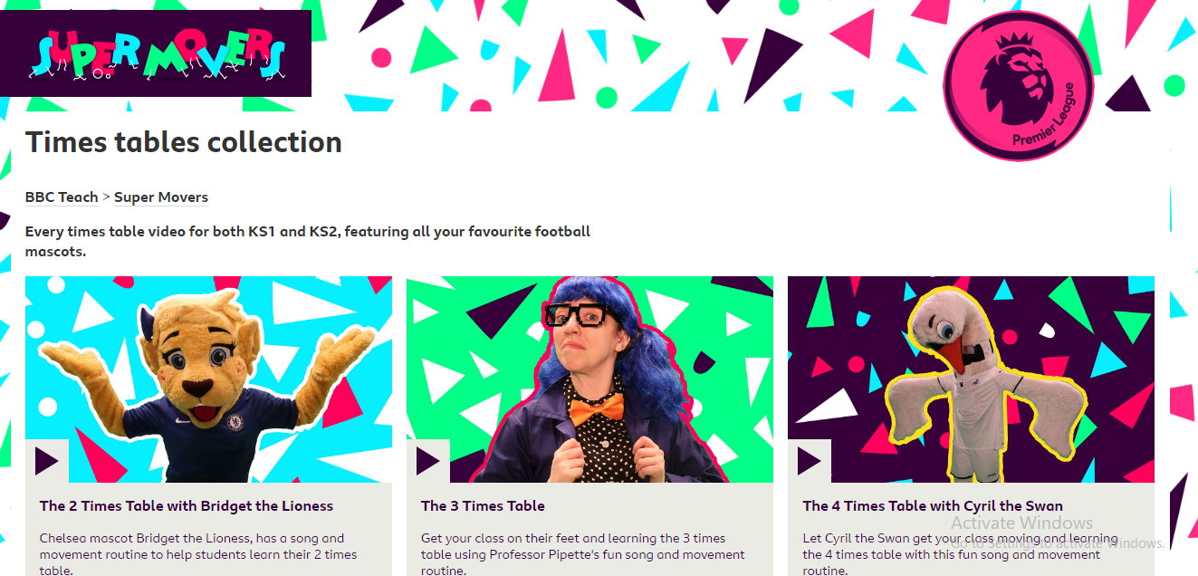
Songs
Number Rock – You Tube
The 12 Times Table Song | Skip Counting by 12 for Kids – YouTube
BBC Teach Supermovers
Times tables collection - BBC Teach

Slide 17

Useful Websites
https://www.topmarks.co.uk/maths-games/hit-the-button
https://play.ttrockstars.com/auth/school/student/30021/password
https://www.timestables.co.uk/times-tables-memory.html
https://mathsframe.co.uk/en/resources/resource/477/Multiplication-Tables-Check
https://www.ictgames.com

Slide 18
What language do we use?

